Slide 1
everything educators need to know about copyright
created by Kayla Bird

Slide 2
What is copyright infringement?
Copyright infringement is the use of a work that is copyrighted without permission from the owner.
The penalties for copyright infringement include lawsuits that may lead to:
restraining orders or injunctions (legal orders to stop action)
paying for damages
attorney fees

Slide 3
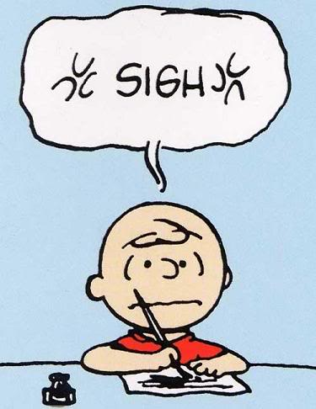
copyright infringement in the classroom
Teachers often infringe copyrighted material without knowing. Examples of copyrighted work that educators might use include:
images
worksheets
videos or music
TV programs
short stories

Slide 4
what is fair use?
Fair use is a principle of copyright that states that the public may use limited portions of copyrighted material for purposes such as commentaries, critiques, parodies, etc. Fair use acts as a defense against copyright infringement as long as it qualifies.

Slide 5
who decides what qualifies as fair use?
Fair use is actually very subjective. Unless you receive a lawsuit for infringement and it is determined as fair use (or not) in court, there is no definition or qualifying statements that determine fair use. However, there are four factors that judges take into consideration when determining if the material was protected by fair use. These include:
purpose/character of use
nature of copyrighted work
amount/substantiality of work taken
effect of use upon potential market

Slide 6
purpose/character of use
The material must be transformed or used in addition to something else (with proper citation) from the original work to create something new for purposes such as increased meaning, new understanding, or for educational/research.
Another issue that must be determined and approached with caution is whether the transformation of the original work is substantial. If the new work is changed, but is still deemed too similar to the original work, the owner has the right to file a lawsuit.

Slide 7
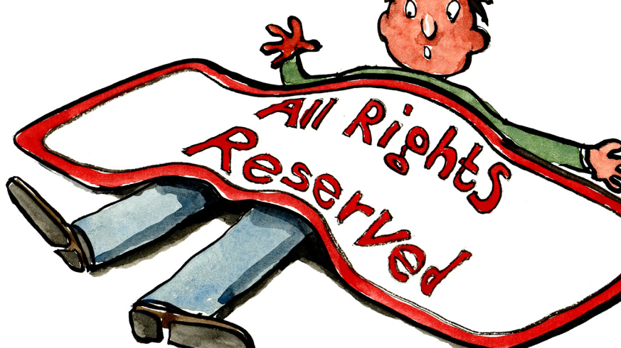
Nature of copyrighted work
There is more freedom to use material from works that are based on factual information (e.g. biographies, nonfiction) because it will help the public.
The fair use defense is stronger for published works because owners have the right to have authority over (1) whether their work is revealed to the public and (2) when their work is revealed to the public.

Slide 8
Amount/substantiality of work taken
It is best to take as least as possible to be protected by fair use.
What is taken should not be the most memorable/important parts. The exception to this is a parody.

Slide 9
Effect of use upon potential market
What you copy should NOT deprive the owner of the work of income or credit for their original ideas.

Slide 10
What does fair use mean for educators?
Educators must be aware of where they are taking information/works from as well as the four guiding principles to ensure fair use.
Teachers should also, to put it simply, use common sense when choosing their materials? Good questions to ask yourself include:
Why am I taking this material…is it for the educational growth of my students and for their understanding or is it because I am too lazy to create my own material/properly site the creator?
Have I seriously considered the consequences of improperly using copyrighted material?
Have I double-checked with the four principles judges use to determine fair use with the work I am using?

Slide 11
What to teach students about copyright
Teachers aren’t the only ones who need to be cautious about copyright infringement– they should also take responsibility for teaching students about copyright infringement in relation to completing assignments.
What to teach:
how to lawfully acquire material that is protected by copyright laws
how to include a fair use statement at the beginning of their work if there is a possibility of a copyright infringement lawsuit
fair use guidelines for different types of media, including text, motion media, illustrations, music, internet, etc.
more info about fair use guidelines can be found here:
http://www.ncpublicschools.org/copyright1.html#2
where to find sources and how to properly site them
consequences of copyright infringement
Teachers should also review students’ work and approach them if they have concerns about copyright infringement.

Slide 12
Sources
http://www.ncpublicschools.org/copyright1.html#2
http://fairuse.stanford.edu/
http://stuweb.hbu.edu/Faculty/dwilson/TreasureHuntonCopyright.html

